Slide 1
Connect or Neglect Group?
Hebron Baptist Church

Slide 2
The Mindset Makes The Difference
NEGLECT GROUP
Lead by a “teacher”
Measures “intent”
Maintenance Minded
Agenda Driven
Lot’s of Motion
Keep it together
CONNECT GROUP
Lead by a “leader”
Measures “fruit”
Growth Minded
Kingdom Driven
Lot’s of Progress
Send leaders forth

Slide 3
Ephesians 4:11-16
¹¹ And He [Christ] personally gave some to be apostles, some prophets, some evangelists, some pastors and teachers, ¹² for the training of the saints in the work of ministry, to build up the body of Christ, ¹³ until we all reach unity in the faith and in the knowledge of God’s Son, growing into a mature man with a stature measured by Christ’s fullness.

Slide 4
Ephesians 4:11-16
¹⁴ Then we will no longer be little children, tossed by the waves and blown around by every wind of teaching, by human cunning with cleverness in the techniques of deceit. ¹⁵ But speaking the truth in love, let us grow in every way into Him who is the head—Christ. ¹⁶ From Him the whole body, fitted and knit together by every supporting ligament, promotes the growth of the body for building up itself in love by the proper working of each individual part.

Slide 5
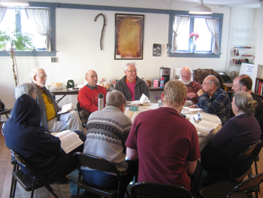
Remember these three things that are critical to your leadership of a Connect Group…

Slide 6
You are the Voice

Slide 7
You are the Hands

Slide 8
You are the Feet

Slide 9
As the Voice…
You prepare and teach God’s Word.
You teach with passion.
You teach with interaction.
You teach with application.
You equip your members to serve.
But it does not end there…

Slide 10
As the Hands…
You minister to every member of your group.
You know every member personally.
You connect with every member regularly.
You engage your group in ministering to others.
As a leader, you either “do it, delegate it, or get it done,” but it does get done because you are the Hands.
You understand the role of the roll.

Slide 11
As the Feet…
You have a Great Commission Focus.
Outreach is a priority, not an afterthought, or worse yet, an obsolete subject.
Fellowships are commonplace.
Ministry extends beyond the membership.
The group members are equipped and challenged to both invite and invest in the unchurched.

Slide 12
So which is it?
Are you leading a CONNECT group or a NEGLECT group?

