Slide 1
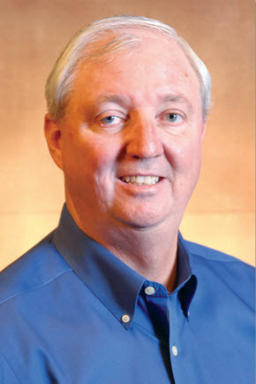
Making Life Bible Study More Evangelistic
Steve Parr
Author of “Sunday School That Really Works”

Slide 2
Why Through LBS Groups?
S
Specialists
D
Designed
The leaders are specialists.
It is designed for specific age groupings.
1st
Discipleship
E
It is the first line of discipleship.
Effective
It is the most effective assimilation tool.
F
Follow-up
It is set up for follow-up.

Slide 3
Open the Front Door
Front Door: Guests are invited to and attending the
group.
80% of lost, unchurched adults say they would attend
church if. . .
A class without guests has one of three problems:
They don’t understand the purpose of LBS.
The teaching and class dynamics are poor.
They are not being challenged.

Slide 4
Open the Side Doors
Side Doors: Fellowships are planned with guests invited and present.
How do you impact those that have no interest in a
LBS Group?
Host regular fellowships inviting all members and
prospects.

Slide 5
Open the Gospel Door
Gospel Door: The gospel is presented and an
invitation is extended in during Bible study.
Some people will respond better in the small group than in the large group.
Present the gospel and extend the invitation.

Slide 6
Open the Ministry Door
Ministry Door: Members seek to minister to theunchurched when they are in crisis
Most people come to know Christ when two dynamics are in place.
1- A crisis occurs.
2. A Christian is near by.

Slide 7
Open Heaven’s Door
Heaven’s Door: The class is praying for the lost.
Acts 4:31:
“And when they had prayed, the place where they
Were assembled was shaken, they were all filled with the
Holy Spirit and spoke the word of God with boldness.”

Slide 8
Open the Outreach Door
Outreach Door:
What is your strategy?
Evangelistic groups are led by evangelistic leaders.
Do your group members know how to share their faith?
The class has a strategic plan to reach prospects.
…
…
…

Slide 9
Close the Back Door
Back Door: The class is intentional about assimilation.
Seek to enroll prospects and automatically enroll
new believers.
Minister to all members weekly.
Make a personal connection to new members.
Have lot’s of fellowship.

Slide 10
sparr@gabaptist.net
Follow me
www
Facebook
ssunderparr
Twitter
@steveparr
www.steveparr.net

