Slide 1
Reversing the Erosion of Sunday Morning Bible Study
Things that matter, things that don’t, and how to turn it around
Dr. Steve R. Parr

Slide 2
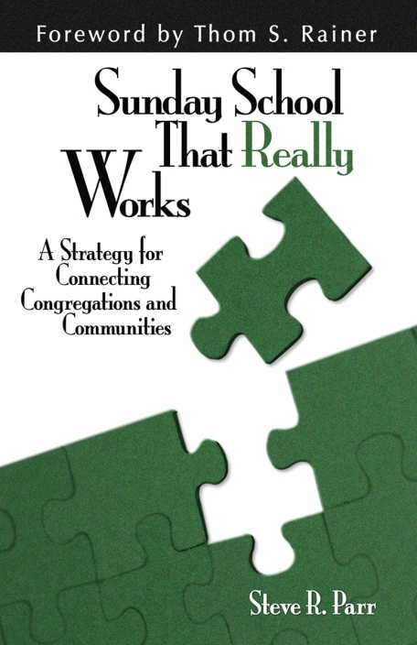
You Know it is Functioning Properly
…If THE LOST ARE BEING REACHED
…If LIVES ARE BEING CHANGED
…If LEADERS ARE BEING SENT

Slide 3
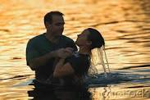
The Simplest Metric for Evaluation
How do the number of groups that you have compare to the number of baptisms?

Slide 4
All 6 Key Strategies Apply
Praying for the lost
Proclamation of the gospel
Personal Evangelism Training
Servant Evangelism
Event Evangelism
Team Evangelism

Slide 5
The Most Common Mistake
The assumption that groups will function properly on auto-pilot…

Slide 6
Things That Matter Less Than You Think
What you call it.
When the groups meet.
Whether the pastor leads a group.
The specific line of curriculum.

Slide 7
Things That Matter More Than You Think
The Attitude of Key Leaders.
The Leader Training Strategy.
The Orientation of the groups.
(Outreach Oriented or Deeper Oriented?)
The Number of Leaders.

Slide 8
Want to turn it outward?
Elevate your groups. Elevate the purpose of the groups.
2. Begin weekday groups without dismantling
Sunday morning.
3. Open the side doors. Groups that
fellowship more reach more.
4. Focus on what WORKS.

Slide 9
W.O.R.K.S.
Wants to grow
Organizes to grow
Reaches out to the unchurched
Keeps the members connected
Sharpens the skills of the leaders

Slide 11
Follow me on twitter @steverparr
See my resources at www.steveparr.net
Email is sparr@gabaptist.org

